Slide 1
Announcements
Spring Break March 15-19
PSAT for 9th and 10th Graders is Weds. March 24th
Weds. March 31 BISD Early Release Day
Friday, April 9th is International Day Fair

Slide 2
ACC Summer Registration
If you are planning to enroll in an ACC summer class,
paperwork can be found in the library or in your email/ Google Classroom.
https://docs.google.com/document/d/17DMSnqTyq8E9JBczVMSTFEbD6Ha4_2Dv5soI-Yeid00/edit
You have until the end of March to register.
Please speak with Mr. Gordon or Mr. Longoria to decide which classes to take.

Slide 3
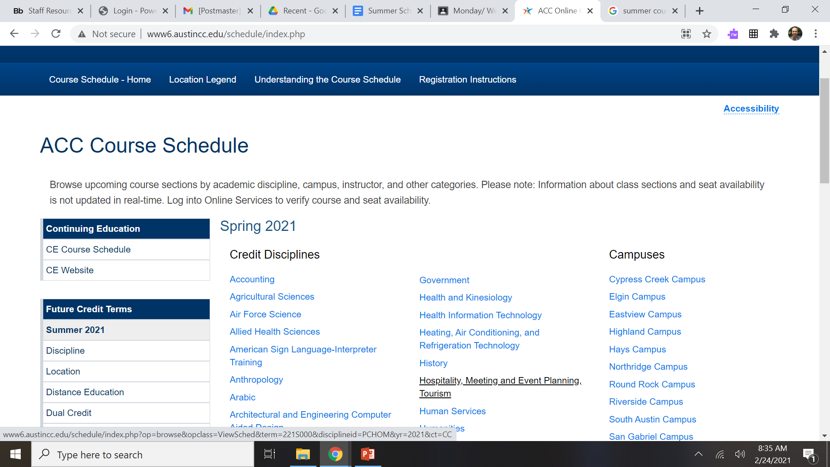

ACC Summer Course Schedule
Below is the link to look at the ACC Course Schedule. Click Summer 2021 “Discipline” on the right hand side.
http://www6.austincc.edu/schedule/index.php

